Slide 1


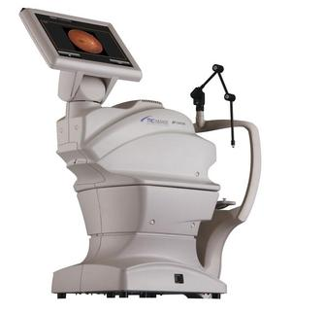

Diabetes Quality Care Team
June 2018 NEWSLETTER
We *see* a bright future in teleophthalmology!
Highlights from this month:
Cameras for all 4 Outreach clinics have received grant funding from the Wisconsin Public Service Commission!
Special thanks to Martha Kindree-Airth for her outstanding grant writing skills
Updates:
Highest number of completed referrals ever in May 2018!
Mobile Camera Team: We are working to prepare for camera installation and training at one Outreach clinic at a time
UW Health in Madison plans to start offering eye photos this summer
Top REFERRERS*
may
  Two way tie!
  (P. Rudy, MD; C. Custer, PA-C)
  2. Two way tie!
  (K. Butterfield, DO;
  A. Gatzke-Plamann, MD)
  One in three providers referred at least 1 patient last month!
  *Based on patient completion of teleophthalmology referrals
Target = 25 per month

